Slide 1
CSE 5914 – Almost Grads
Watson Weather Project
John Herwig, Luke Swint, Holland Clarke

Slide 2
CSE 5914 – Almost Grads
Our Application
Attractive web app with ability to assist with planning through the communication of a Watson Assistant
Focus on weather in your location
Allows users to pass in location information and Chatbot that will provide weather data
Connected to OpenWeatherMap API
Free to use with valuable information

Slide 3
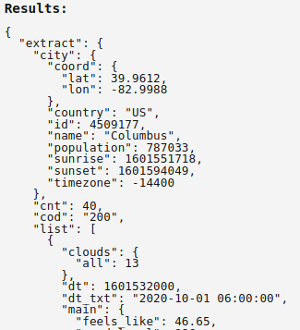
CSE 5914 – Almost Grads
API Connection
OpenWeatherMap will take in one of the following
City
City & State
City & Country
API Response
Notes:
TON OF STUFF AS YI UCAN SEE: including most importantly sunset, temp, population, sunrise/sunset

Slide 4
CSE 5914 – Almost Grads
Progress
Properly Working
Website is successfully deployed to Heroku
Appearance is attractive
Watson assistant provides info of Columbus
Roadblocks
City specification struggling to connect to variable
Miscellaneous
Extensive research into Watson Assistant functionality, as well as flight APIs

Slide 5
CSE 5914 – Almost Grads
Next Steps – Timebox 4
If variable issue can be fixed
User specification of city
All OpenWeatherMap API data accessible
If variable issue can’t be fixed
Connect flight API
Make more of Columbus focused weather/flight information application

Slide 6
CSE 5914 – Almost Grads
Next Steps – Overall Goals
Weather Features
Show the weather for any location
Accessing user location
Flight Features
Show any flight data
Give recommendations based on desired weather
Miscellaneous Features
Assure Watson can understand mistypes & a variety of sentence structures

Slide 7
Demo

